Slide 1
Solution Mockup
TMB Status Prediction
25th Oct ‘24

Slide 2
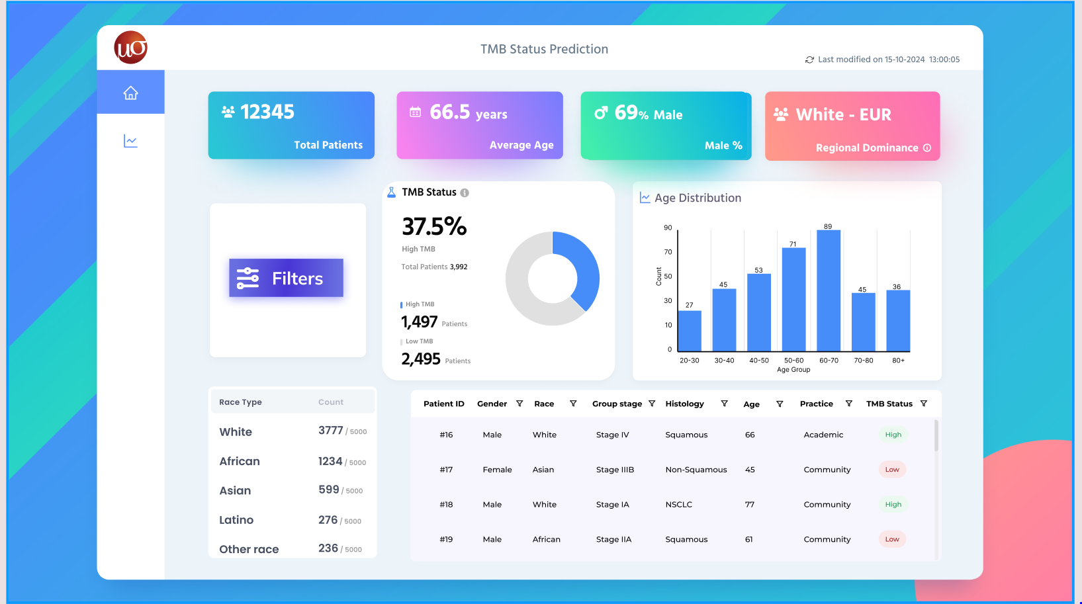

Slide 3
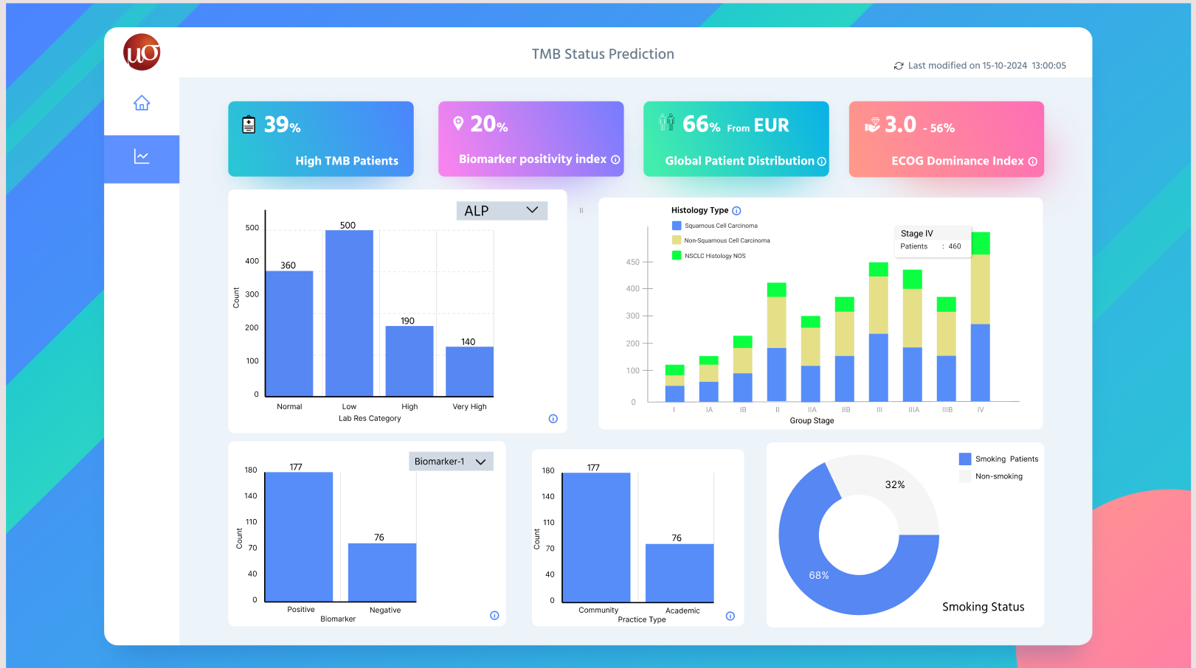

Slide 4
Thank You!

